Slide 1
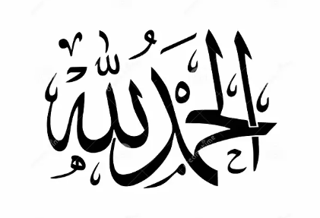
Gratitude is not just saying Alhamdulillah
ECE DEPT TAZKIRAH FEB 2025 Yasser Asrul

Slide 2
Alhamdulillah is an expression we say as a gratitude to Allah SWT for the blessings and sustenance bestowed.
Allah has bestowed upon us many blessings.
Gift of Life
Health
Wealth
Children
Family
Gives us the joy of living.

Slide 3
Saba: 13
ٱعْمَلُوٓا۟ ءَالَ دَاوُۥدَ شُكْرًۭا ۚ وَقَلِيلٌۭ مِّنْ عِبَادِىَ ٱلشَّكُورُ
Work you, O family of Dawud, with thanks!
But few of My servants are grateful
This is the reality, many people says Alhamdulillah, but are we really grateful to Allah?
means, `We said to them: Work with thanks for the blessings that We have bestowed upon you in this world and the Hereafter.’ This indicates that thanks may be expressed by actions as much as by words and intentions.
Abu `Abdur-Rahman Al-Hubuli said, "Prayer is thanks, fasting is thanks, every good deed that you do for the sake of Allah is thanks, and the best of thanks is praise."
(tafsir ibn Kahthir)
ٱعْمَلُوٓا۟ ءَالَ دَاوُۥدَ شُكْرًۭا

Slide 4
METHODS OF GRATITUDE
Grateful from the heart
Have faith and embrace all the blessings of Allah SWT with a heart full of joy, contentment, and acceptance as they are.
Be grateful in times of hardship and happiness

Slide 5
METHODS OF GRATITUDE
Grateful by words
Reading the Quran, Zikr and speak of words of gratitude has (al-khayr) i.e .good for the ear and heart of people.
Whoever believes in Allah and the Last Day, let him speak goodness or remain silent.”
Source: Ṣaḥīḥ al-Bukhārī 6136, Ṣaḥīḥ Muslim 47

Slide 6
METHODS OF GRATITUDE
Grateful by Actions.
Attempt for al-amr bi al-ma’ruf wa al-nahy ‘an al-munkar.
Help people as a gratitude to Allah.
Abu Huraira reported: The Prophet, peace and blessings be upon him, said, “Whoever does not thank people has not thanked Allah.”
Source: Sunan Abī Dāwūd 4811
Solat
Narrated Aisha:
The Prophet (ﷺ) used to offer prayer at night (for such a long time) that his feet used to crack. I said, "O Allah's Messenger (ﷺ)! Why do you do it since Allah has forgiven you your faults of the past and those to follow?
يَا عَائِشَةُ أَفَلاَ أَكُونُ عَبْدًا شَكُورًا
Ya Aisha, Shouldn't I love to be a thankful slave (of Allah)?

Slide 7
SUMMARY AND CONCLUSION
Surah al-Nahl (114)
وَاشْكُرُوا نِعْمَتَ اللَّـهِ إِن كُنتُمْ إِيَّاهُ تَعْبُدُونَ
be grateful for the favours of Allah, if it is He Whom ye serve.
Let us improve our gratefulness to Allah swt for all the Nikmat we get.

